Slide 1
Nautilus Minerals
Global Vision
Jonathan Lowe
V.P. Strategic Development and Exploration
May 2013

Slide 2
Disclaimer and Legal Notice
This Presentation may contain forward-looking statements within the meaning of the United States Securities Exchange Act of 1934 and forward-looking information within the meaning of applicable Canadian securities law.
Material forward-looking statements and forward-looking information include, but are not limited to statements or information with respect to the Company’s ability to locate, mine and transport mineralized material from the seafloor; estimates of future production; the method of transport and amount of mineralized material from the Company’s Solwara project; estimates of anticipated costs and expenditures; development and production timelines; the potential commercial extraction of seafloor resources in the CCZ, further development of TOML’s CCZ territory and other potential resources in TOML’s CCZ territory; the Company’s ability to finalise the termination of contracts with suppliers; the Company having sufficient cash to support it moving forward.
We have made numerous assumptions about the material forward-looking statements and information contained herein, including those relating to: the future price of copper, gold, silver and zinc; anticipated costs and expenditures; and our ability to achieve our goals. Even though our management believes that the assumptions made and the expectations represented by such statements or information are reasonable, there can be no assurance that the forward-looking statement or information will prove to be accurate. Accordingly you should not place undue reliance on forward-looking statements or information.
Forward-looking statements and information by their nature involve known and unknown risks, uncertainties and other factors which may cause the actual results to differ materially from those described in forward-looking statements or information. "Risk Factors" are presented in the Company's most recent Annual Information Form, available on SEDAR (www.sedar.com). Except as required by law, we undertake no obligation to update forward-looking statements and information as conditions change.
No information in this presentation shall constitute an invitation to invest in Nautilus or any entities of the Nautilus Group. Neither Nautilus, nor any entities of the Nautilus Group, nor their respective officers, employees or agents, shall be liable for any loss, damage or expense however caused (including through negligence) which you may directly or indirectly suffer in connection with this presentation including, without limitation, any loss of profit, indirect, incidental or consequential loss.
This information is not intended to take the place of professional advice and you should not take action on specific issues in reliance on this information.
While efforts are made to keep the information in this presentation accurate and timely, neither Nautilus nor any of the entities of the Nautilus Group guarantee or endorse the content, accuracy or completeness of the information herein. You are referred to the Company's documents filed on SEDAR.
All graphics, effects, processes, information and data in this Presentation are owned or used under license by Nautilus. Any reproduction or dissemination, in whole or in part, is strictly prohibited.
This presentation does not constitute an offer to sell or a solicitation of an offer to buy Nautilus common shares. ‪In the United Kingdom this presentation is only directed at (i) persons falling within Article 49(2)(a) to (d) of the Financial Services and Markets Act 2000 (Financial Promotion) Order 2005 (as amended) and (ii) persons to whom the communication may otherwise lawfully be made (together 'relevant persons').‪This presentation must not be acted on or relied upon by any persons who are not relevant persons. Any investment or investment activity to which this presentation relates is available only to relevant persons and will be engaged in only with relevant persons.
Information contained herein includes references to the Company’s most recent 43-101 Technical Reports as filed on SEDAR.

Slide 3
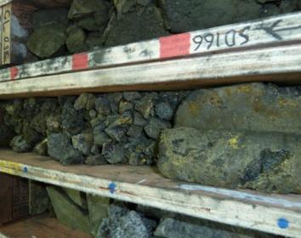
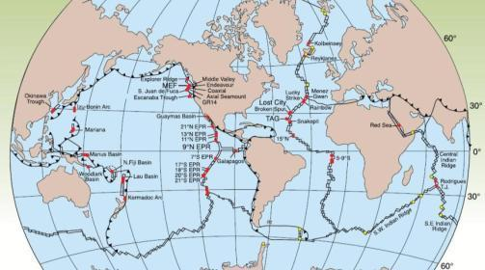
Where in the World........
can you find high grade copper, zinc, gold and silver in abundant quantities...
30% Copper intercepts from Solwara 1
Potentially hundreds of seafloor massive sulfide sites around the world
Figure after Baker et al., 1995; German and Von Damm, 2004; Hannington et al., 2005; Koschinsky et al., 2006
...across the globe?

Slide 4
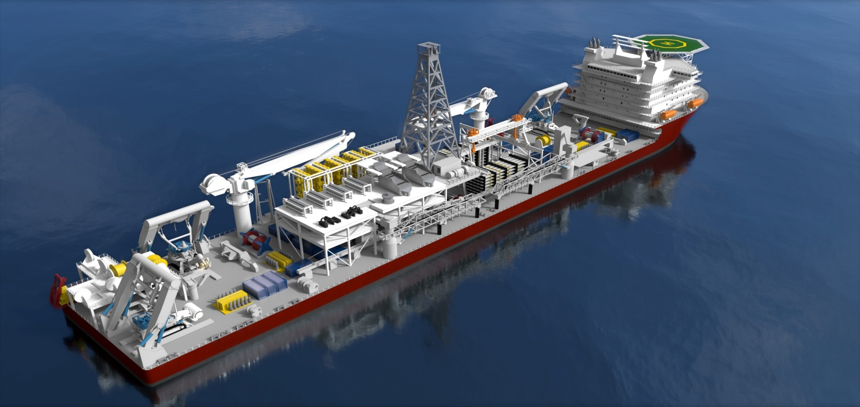
Where in the World ........
can a company extract high grade material on one deposit and move the whole production system to the next deposit
...with minimal infrastructure and improved worker safety?

Slide 5
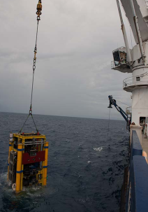
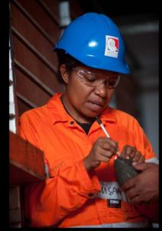
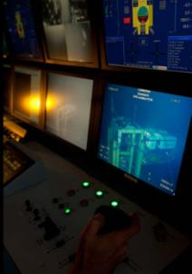
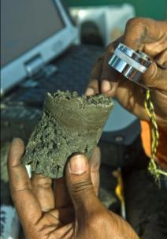




Who is Nautilus Minerals? – Nautilus’ Mission
To create sustainable value for stakeholders through the discovery and development of mineral resources on the ocean floor
Major Industry Shareholders
21.0%
16.9%
11.1%
4.5%

Slide 6
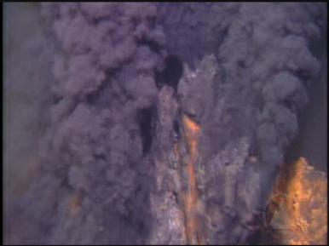
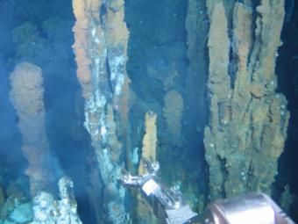
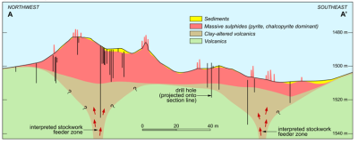
Seafloor Massive Sulphides (SMS)
Faults and Chimneys
Sulfide Mound Development
Sedimentation
Precipitation
Replacement and Remobilisation

Slide 7
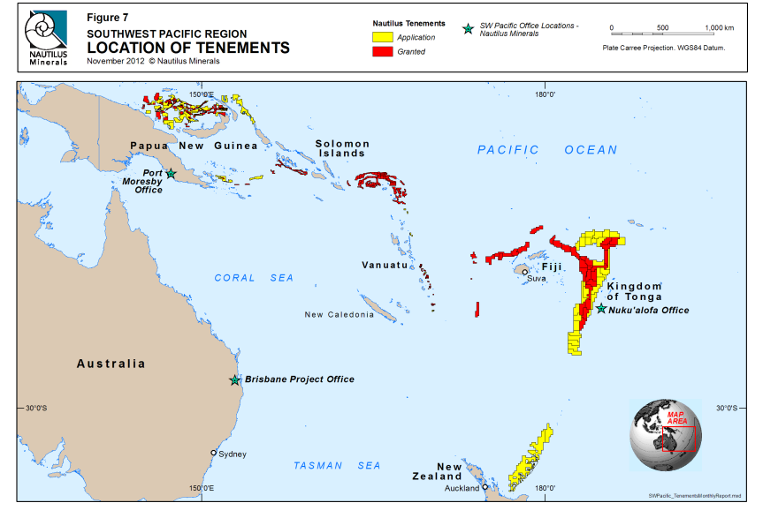
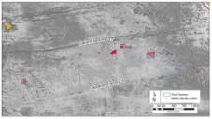
Focus of Prospecting
Notes:
7

Slide 8
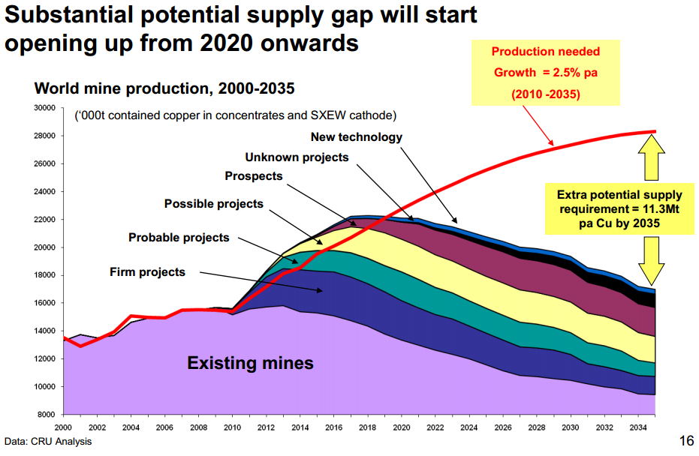
Why? Longer Term – nobody sees a source

Slide 9
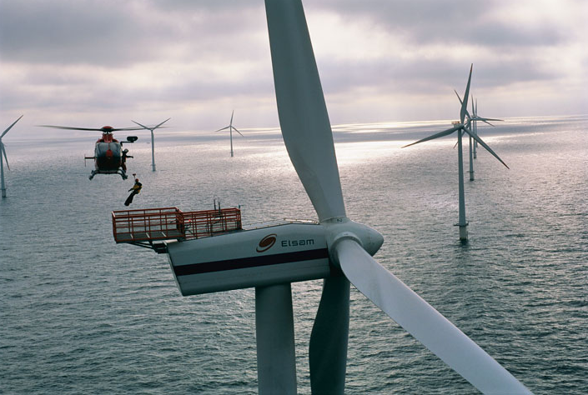
Minerals and Metals for a Green Economy
1 Wind Turbine:
500 kg of Ni
1000 kg of Cu
12x more Cu to create 1kw than conventional power generation

Slide 10
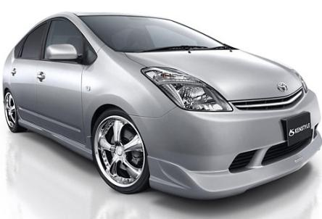
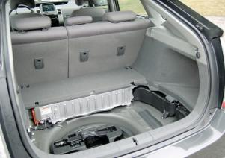
Minerals and Metals for a Green Economy
An electric vehicle contains over TWICE the Copper content of the average car – 2 km of copper wiring
Nickel and Copper essential for batteries in Hybrid Cars

Slide 11
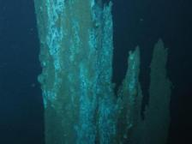
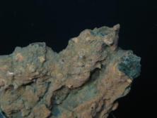
Social and Environmental Advantages
Average Reserve Grade (%) of Land-Based Copper Projects:
Seafloor Massive Sulphide (SMS) deposits – HIGH GRADES of copper, gold, zinc & silver
Minimal overburden, which on land can be up to 75% of material moved
Less ore needed to provide the same amount of metal; small physical footprint
No indigenous or local populations to disrupt
Source: Source: Brook Hunt, a Wood Mackenzie Company
Nautilus Resource Estimate prepared by Ian Lipton, BSc (Hons), FAusIMM, Principal Geologist, Golder Associates Pty Ltd. Effective Date: 25 Nov 2011 . Mineral Resources based on 2.6% Cu eq cut-off grade
Notes:
11

Slide 12
Social License to Operate
Seafloor Production System
What are we seeking acceptance for?
Disaggregate seafloor material.
Transport the material to a ship.
Transport the material to market.
Production Support Vessel (PSV)
Production Support Vessel (PSV)
Riser and Lifting System (RALS)
Seafloor Production Tools (SPTs)
Image: Seafloor Production System

Slide 13
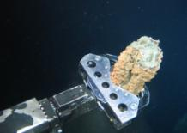
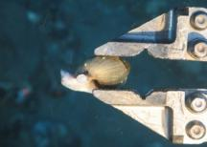
Precautionary Approach: Achieving Independence
Duke University
Scripps Institution of Oceanography
University of Toronto, Canada
Woods Hole Oceanographic Institute
CSIRO, Australia
Hydrobiology, Australia
University of Papua New Guinea
Coffey Natural Systems, Australia
Rabaul Volcano Observatory, PNG
Asia Pacific Applied Science Associates (APASA), Australia
Australian National University
Curtin University of Technology, Australia
James Cook University, Australia
Charles Darwin University, Australia
Independent researchers
Freedom to publish
Independent reviewers
Engaged by DEC
Transparency
EIS and all supporting studies on website
Images: Collecting chimney sample; collecting snail sample

Slide 14
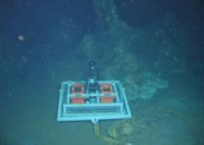
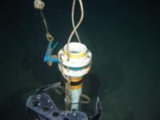

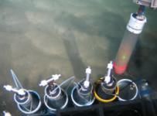

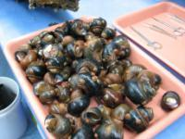
Studies (note this is not an exhaustive list)
Biology Studies:
Macrofauna (incl., DNA/genetic studies)
Benthic Habitat Assessment
Bioaccumulation
Bioluminescence
Existing Resource Utilisation
Hazard and Risk Assessment
Hydrodynamic Modelling:
Cutting
Dewatering
Noise and Light
Oceanography (12 mo, full column)
Sedimentation Rates (36 mo, ongoing)
Sediment Chemistry
Video Survey (>100,000 obs)
Water Quality
Time Lapse Camera
Sediment Trap
Hard Substrate Sampling
Soft Substrate Sampling
Additional objective: science will also benefit from additional deep sea studies conducted to obtain data for the EIS

Slide 15
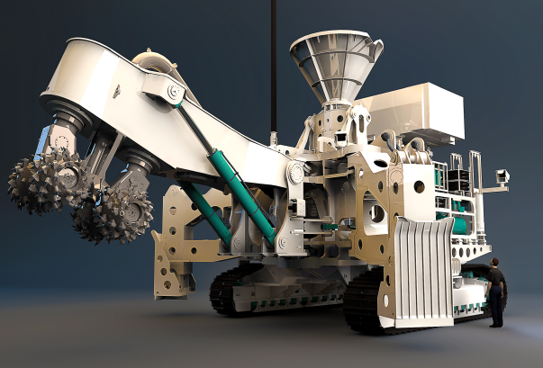
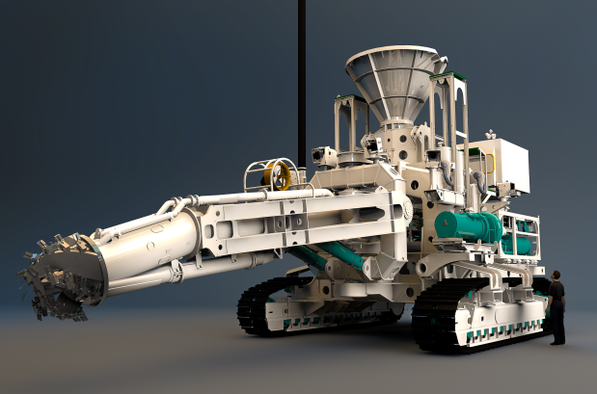
Seafloor Production System
Key Components
Seafloor Production Tools (SPTs)
Riser and Lifting System (RALS)
Production Support Vessel (PSV)
Equipment either existing of an adaption of existing offshore technology
Notes:
This slide gets to the heart of what we intend to do – we call it our Seafloor production system.
It is comprised of three components. Starting at the bottom.
The seafloor production tools. We will have three of these operating on the seafloor at a depth of 1600 metres, controlled by operators on the ship above. They will disaggregate the material and reduce it to a maximum size of 50 ml. The material is quite friable and easy to cut, and the process does not require any blasting or explosives.
Once the material is cut from the seafloor, it is collected by a collecting machine, which is essentially a large vacuum cleaner which pumps it as a seawater slurry via a riser and lifter system to the ship on the surface.
The last component is the seafloor production vessel, which serves as the operational base, and I will say more about each of these components.

Slide 16
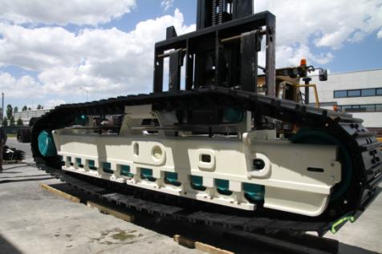
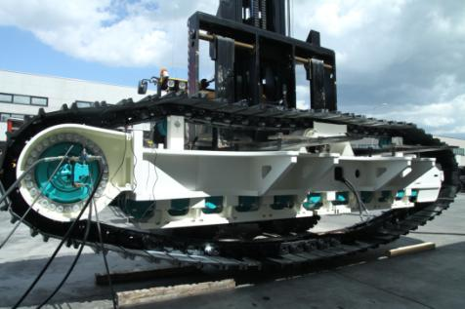
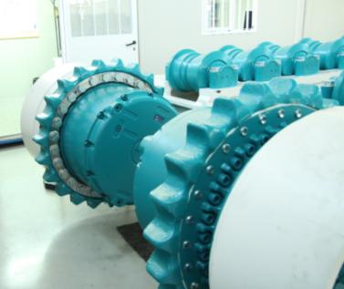
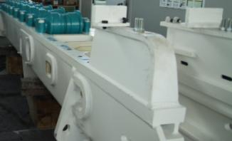
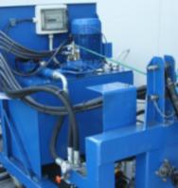
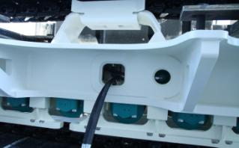
Solwara 1 Project Build - SPTs Taking Shape

Slide 17
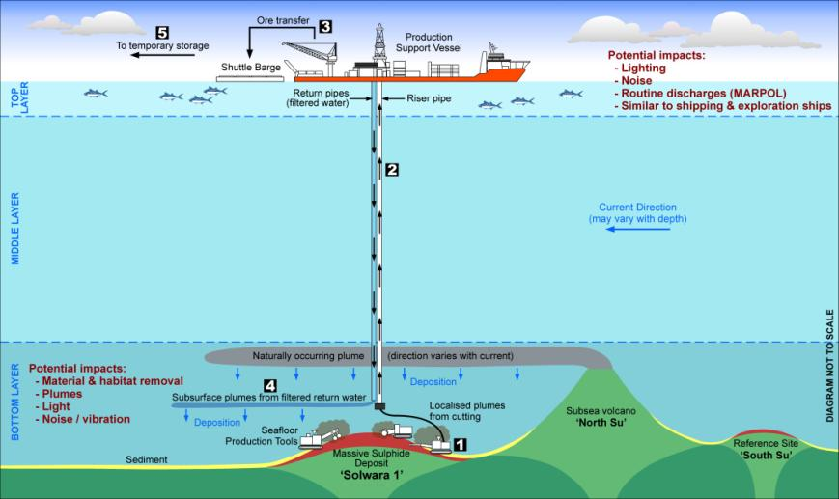

Potential Impacts (note: not to scale)
Local Focus
International Focus

Slide 18
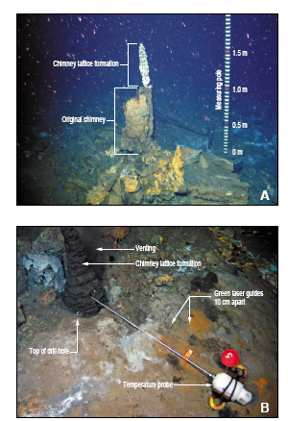
Testable Propositions
It will recover
Venting will continue
Chimneys will reform
Fauna will return

Slide 19
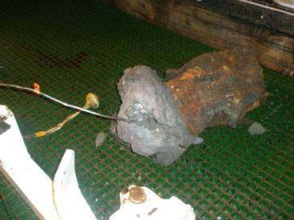
Testable Propositions
It will recover
Venting will continue
Chimneys will reform
Fauna will return
2008
2010
2 years later....

Slide 20
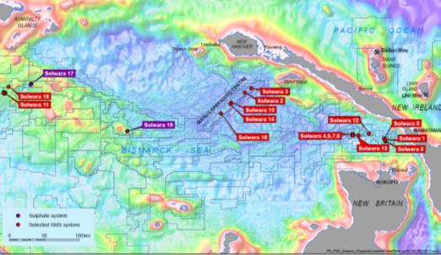
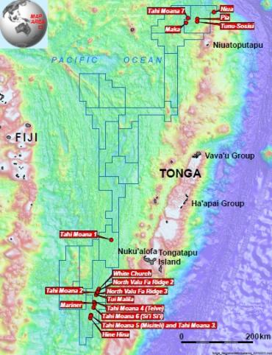
Prospecting Success in the South west Pacific
Bismarck Sea Exploration
Kingdom of Tonga Exploration
Mata
Fonualei South
Solwara 1
19 prospects identified in Bismarck Sea
19 prospects identified in Tonga

Slide 21
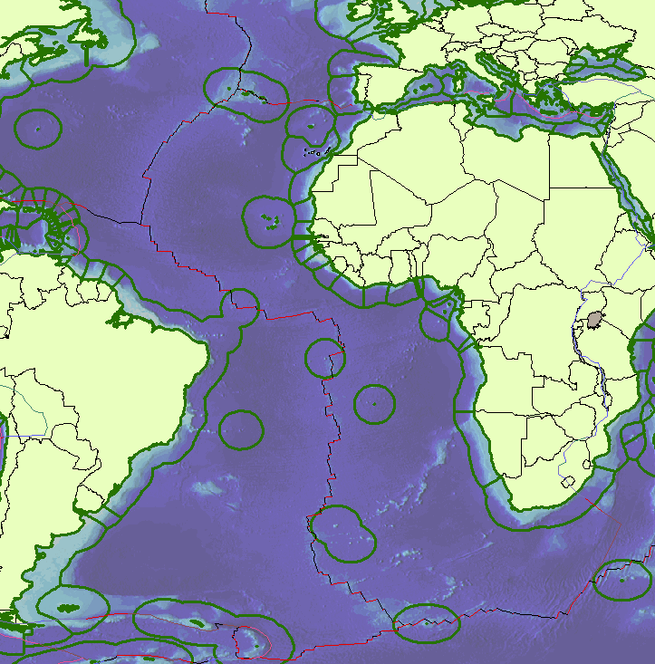
Areas of Operation in the Atlantic
Nautilus
French
Russians
Germans
Chinese

Slide 22
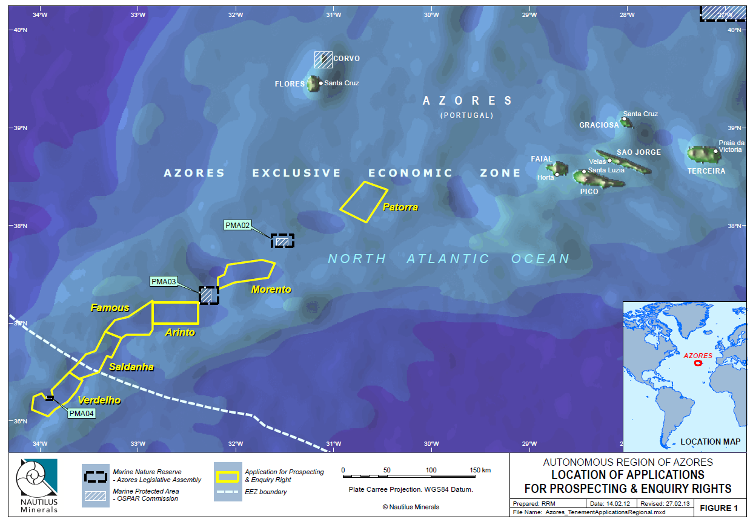
Tenement Applications - Azores

Slide 23
Jonathan Lowe Vice President Strategic Development and Exploration jjl@nautilusminerals.com www.nautilusminerals.com www.cares.nautilusminerals.com

